Slide 1
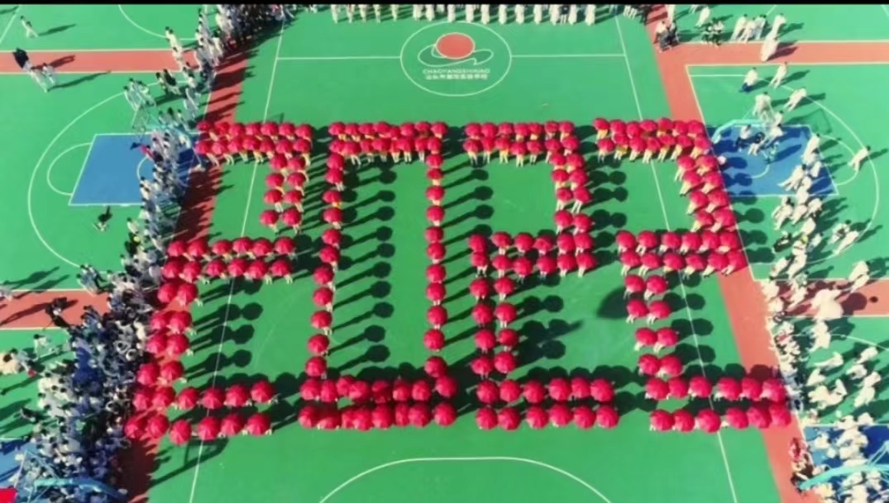
The power of the words Learn to encourage others
潮汕口音特色英语演讲

Slide 2
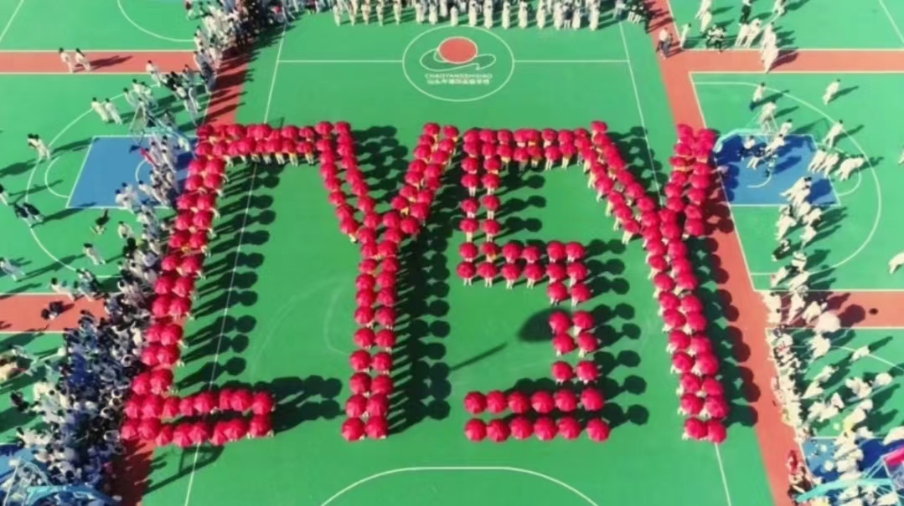
Cysy Sport Meeting

Slide 3


Results
Satisfaction Award
achieve unsatisfactory results

Slide 4
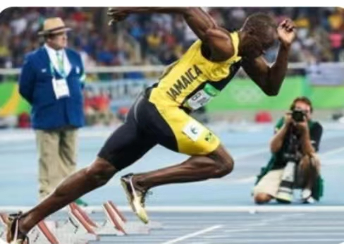
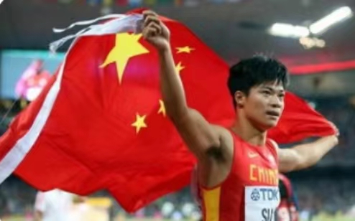
What I imagined
I'm very fast
I'm a champion.

Slide 5
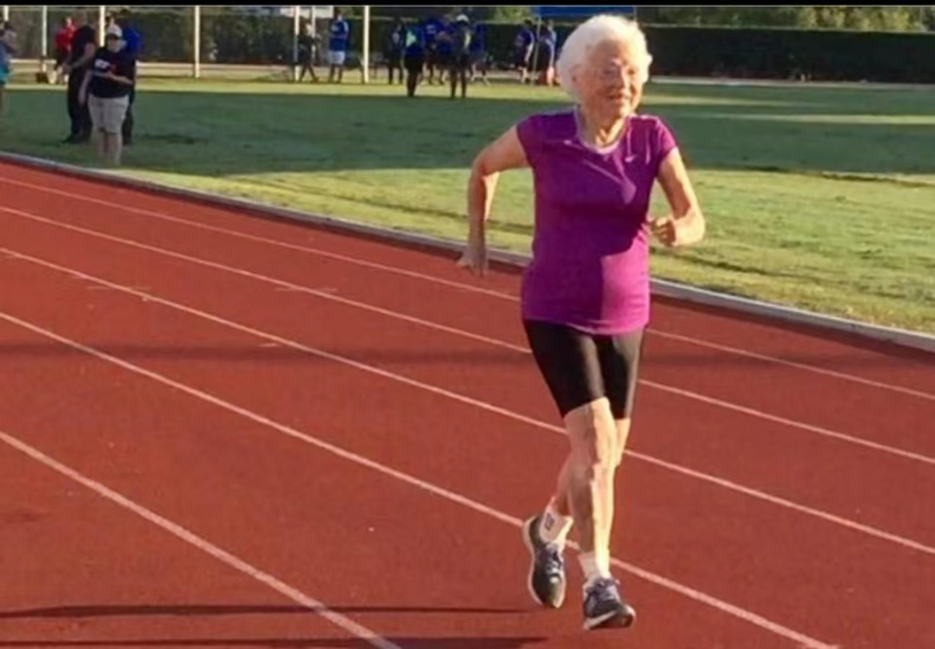
In fact

Slide 6
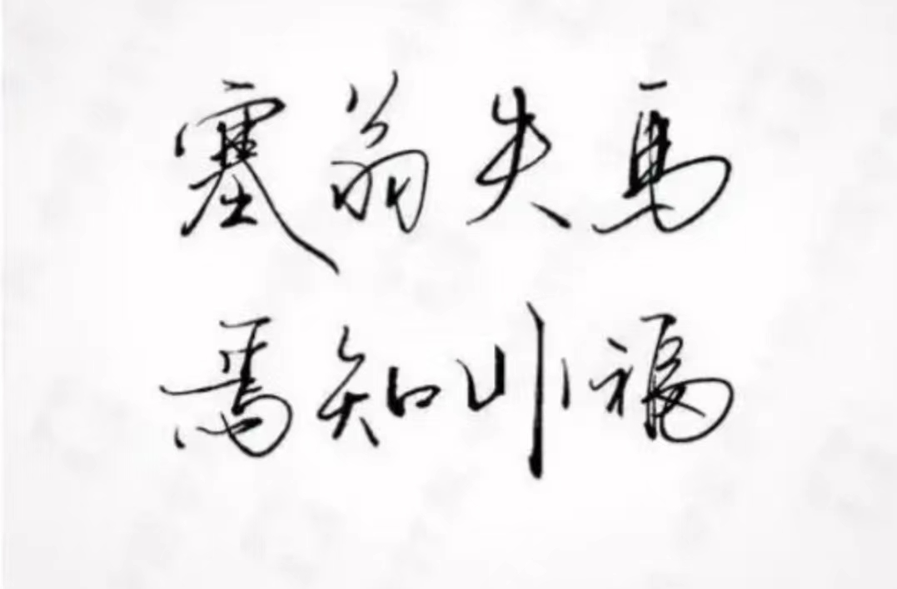
Mr.Sai lost a horse, no know it yes no yes luckly

Slide 7
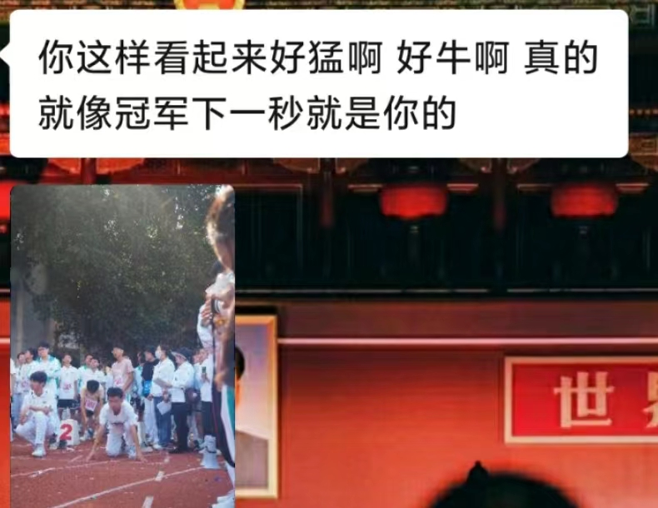
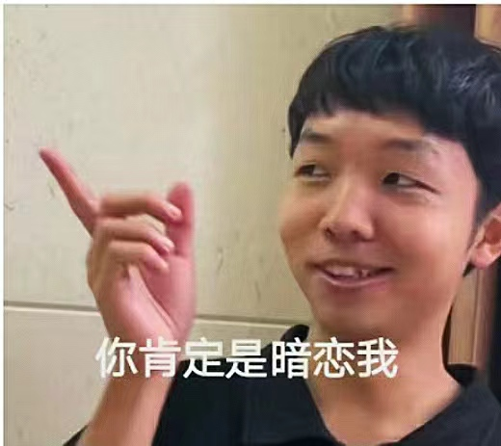

Slide 8
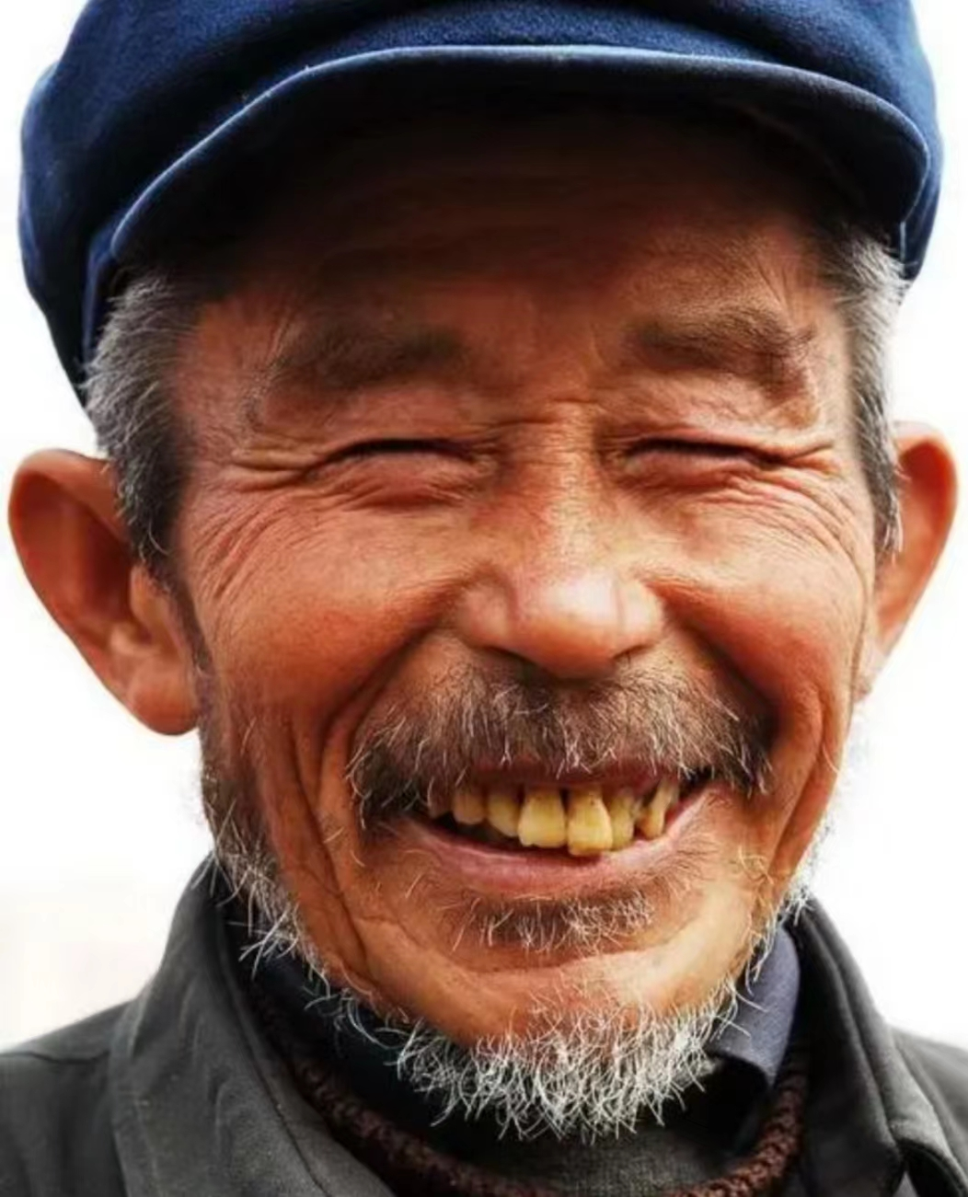

Crazy excitrd alive

Slide 9

This is more unexpected than the high school entrance exam English Test 98 points

Slide 10

Learn to encourage others

Slide 11

Great words are warm in March, hurtful words are cold in June. +

Slide 12

Learn to speak learn to express

Slide 13

A sincere expression of appreciation for others

Slide 14
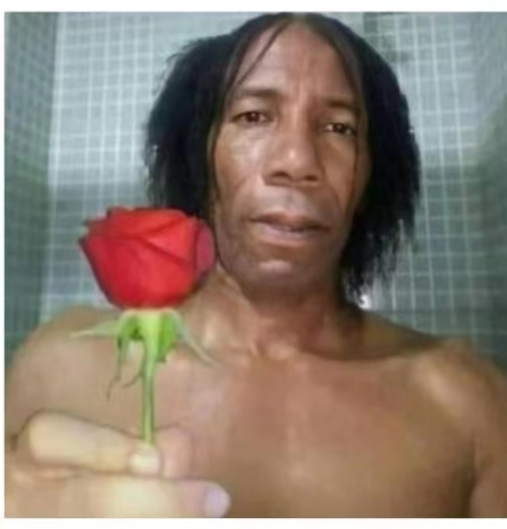
Thank you ! 早点去休息吧！ （结束话题时的礼貌用语）

